Slide 1

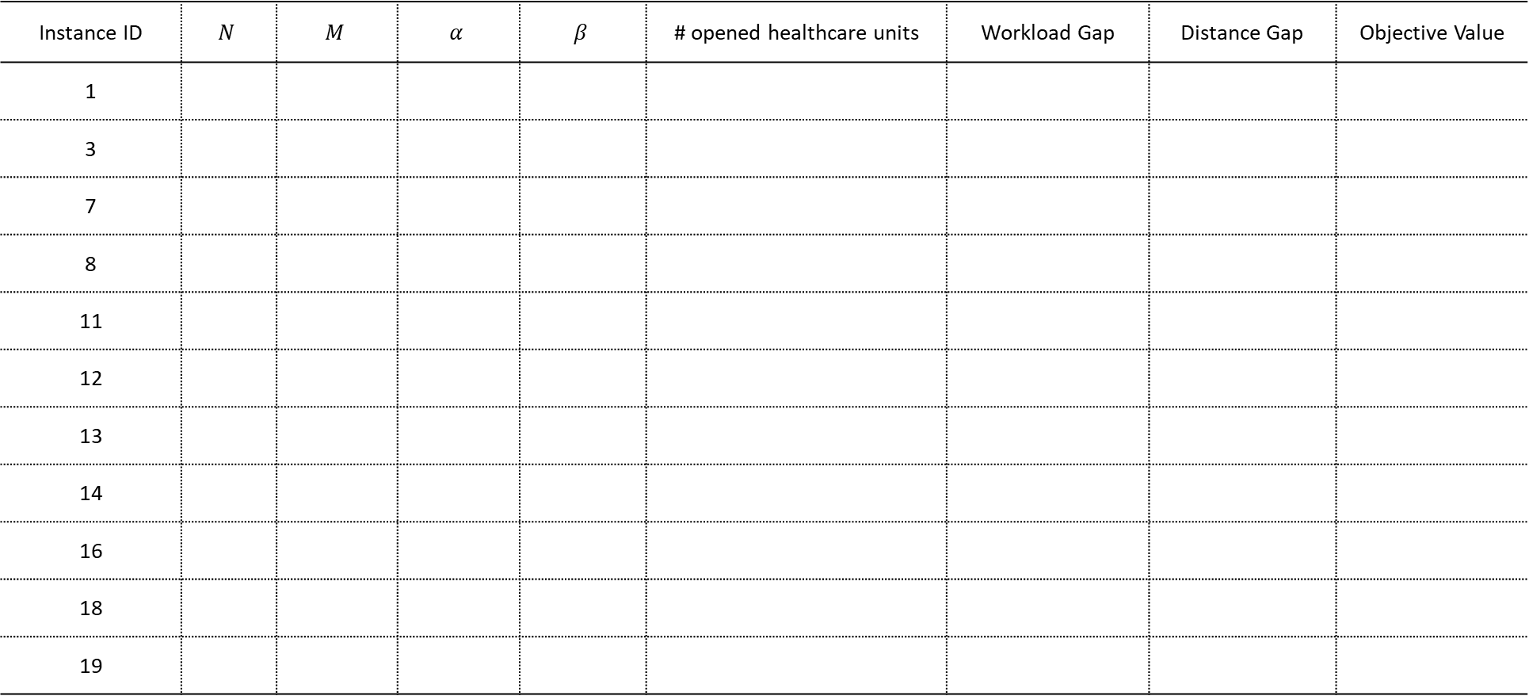
Results
Instance ID | $$N$$ | $$M$$ | $$α$$ | $$β$$ | # opened healthcare units | Workload Gap | Distance Gap | Objective Value
1
3
7
8
11
12
13
14
16
18
19

